Slide 1


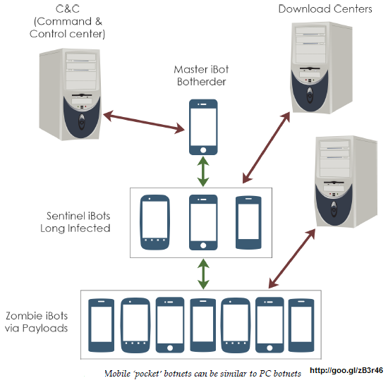

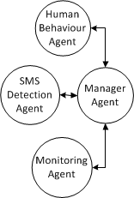
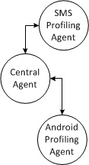
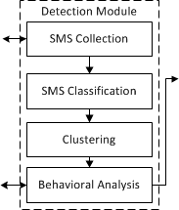
SMS Mobile Botnet Detection Using A Multi-Agent System
Abdullah Alzahrani, Natalia Stakhanova, and Ali A. Ghorbani
Faculty of Computer Science, University of new Brunswick
Mobile botnet is a set of compromised smartphones that share the same command and control (C&C) infrastructure, which are controlled by a bot master to perform a variety of malicious attacks.
Our goal
Develop a hybrid model of SMS botnet detector
Features:
a combination of signature-based and anomaly-based approaches
use multi-agent technology to detect SMS botnet
Android Smartphone Agents:
Manager Agent:
  Register to central agent provider.
  Interact with central agent.
  Manage the interaction communication between local agents.
  Send data to Android proﬁling agent.
SMS Detection Agent:
  Register with SMS proﬁling service.
  Obtain copy of SMS signatures.
  Scan Incoming and outgoing SMS.
Monitoring Agent:
  Report access to browse or other apps.
  Check Wi-Fi status and Internet access.
  Spot any setting changes.
Human-Behaviour Agent:
  Monitors user connectivity time.
  Maintains the whitelist and blacklist.
  Reports mobile phone daily usage.
Central Server Agents:
Central Agent.
  Register device and add it to the subscriber list.
  Update, block, and delete Android manager agents.
  Get proﬁle updates and send them to Android proﬁling service provider.
Android Proﬁling Agent
  Maintain a proﬁle database for all subscribing smartphones.
  Update the received changes.
  Respond to Detection Module requests.
SMS Proﬁling Agent:
  Handle the received suspicious SMS and then send it to Detection Module.
  Maintain the updated signature for each SMS detection agent.
  Handle SMS logs and request an update within speciﬁc time.
Detection Module
SMS Collection:
  Responsible for collecting, combining, storing and retrieving data to perform more robust detection.
SMS Classiﬁcation:
  Utilize Content-based approach (N-gram):
    very fast and robust algorithm.
    Create automatic signatures of SMS.
  Apply machine-learning algorithm to learn the signatures and then use it to classify the SMS messages .
  Generated signatures are used to scan incoming and outgoing SMS on smartphones.
Clustering:
  An unsupervised learning method which takes a set of data and then groups it based on the similarities.
  Does not require class labels.
  X-means clustering:
    Based on K-means.
    Its simplicity of implementation.
    Find the number of clusters dynamically.
Behavioural Analysis:
  Used to look for evidence of compromise rather than any speciﬁc attack.
  Behavioral proﬁling:
    Detect outgoing SMS that is sent without user permission.
  Alert Correlation:
    Identify any correlations between alerts from the clusters and any abnormal activities.
SMS Signature-Based Detection
  Focusing on incoming and outgoing SMS messages.
  Real-time content-based signature detection.
  Pattern Matching.
  It’s ability to reduce search space.
    Decision-and-Action Module
Output received from the detection module.
  Response plan and action:
    Malicious correspondent’s phone number and Block SMS
    Similar characteristics of malicious SMS and group them by their common features.

